Slide 1
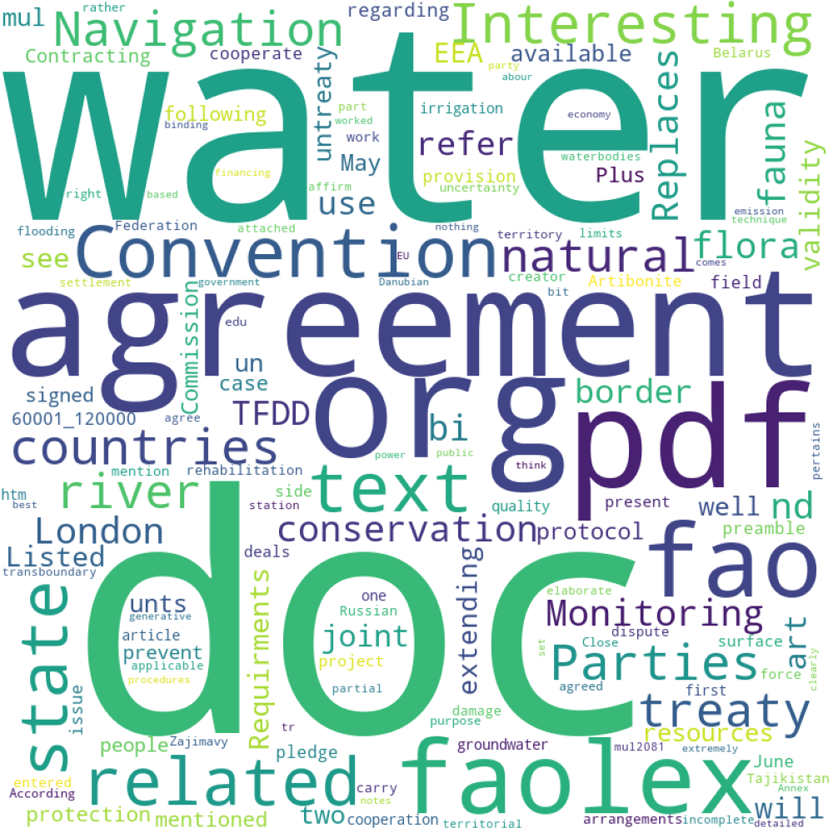
Water conflict

Slide 2
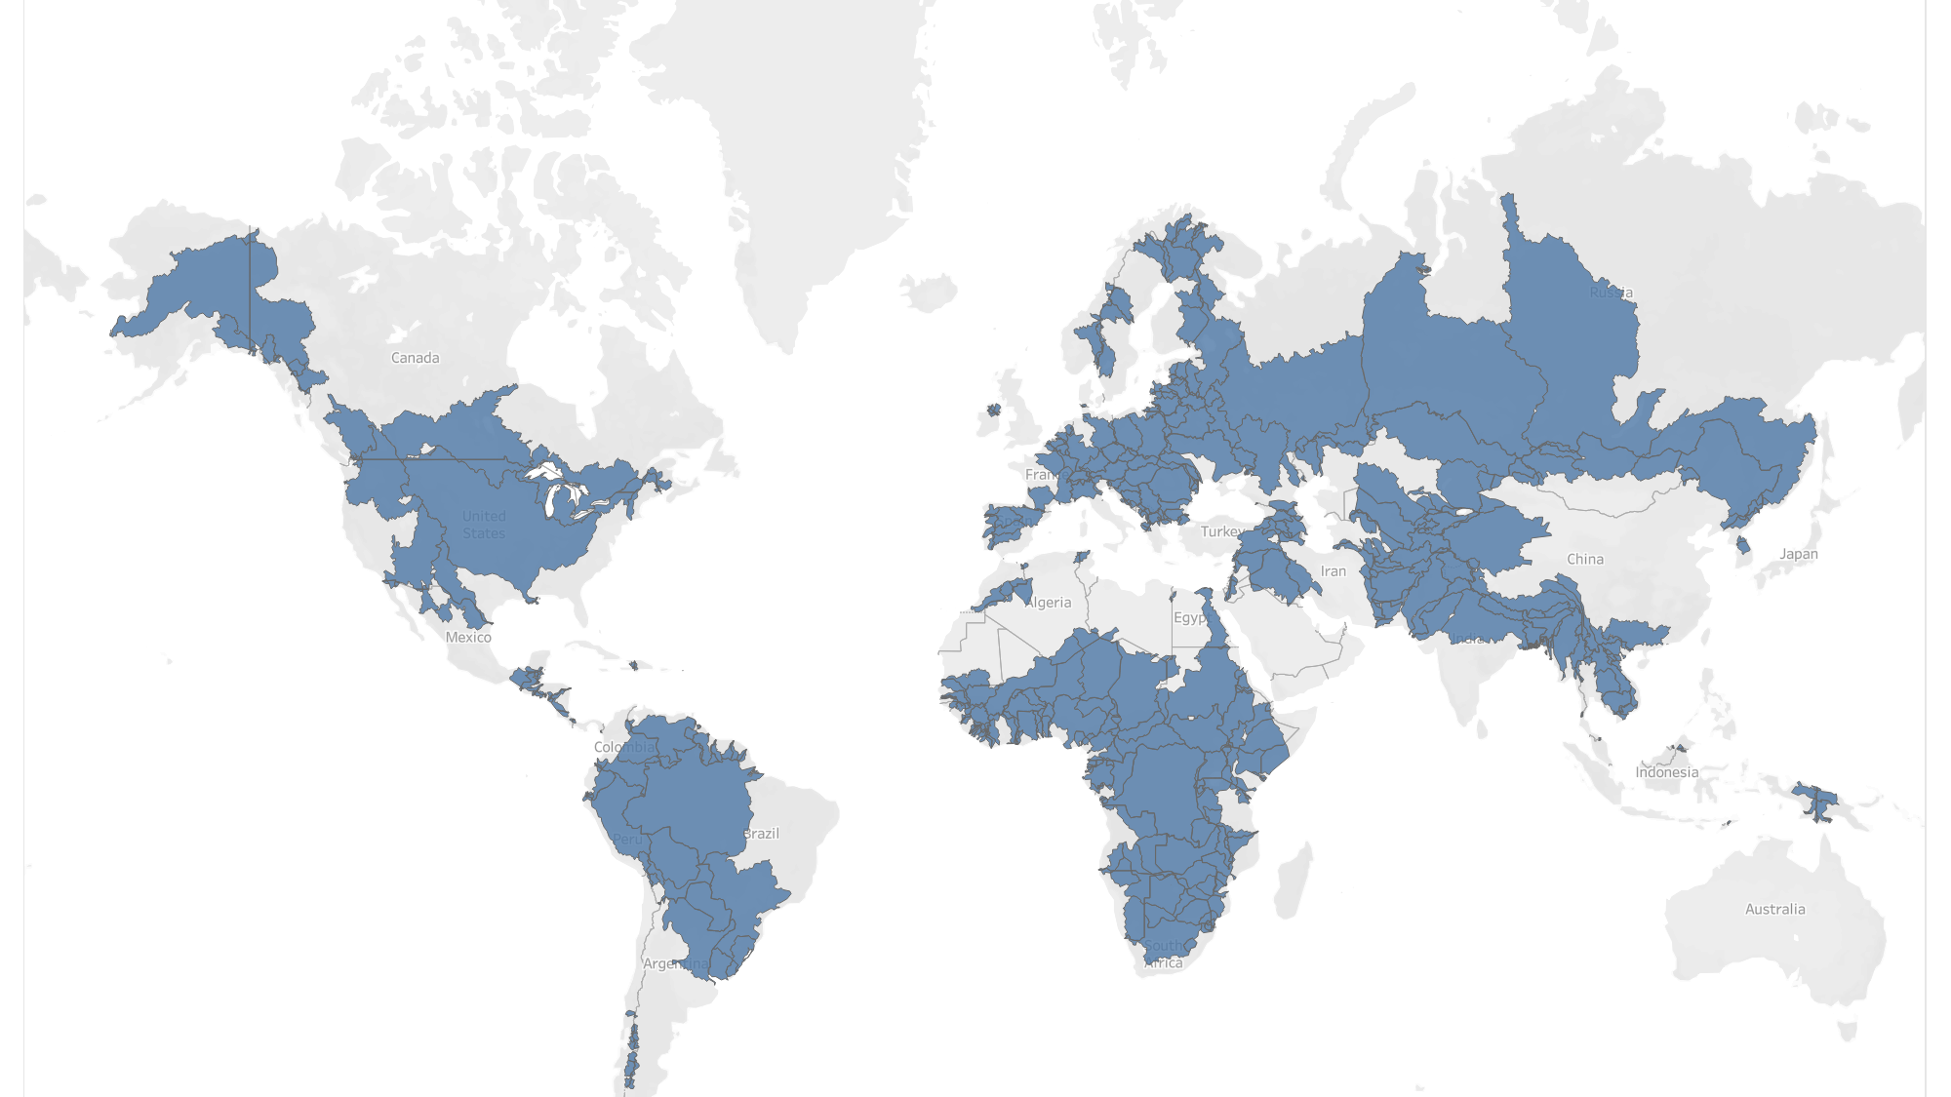
Transnational Water Basins

Slide 3
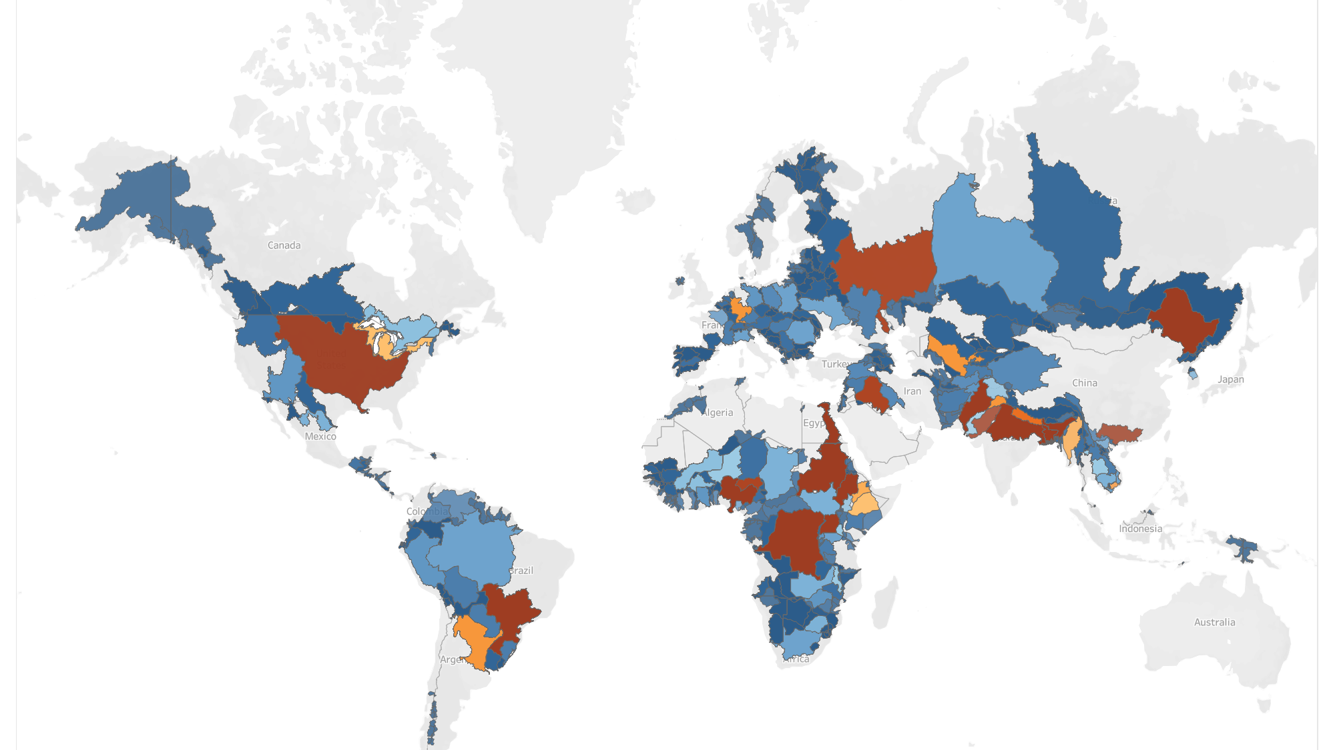
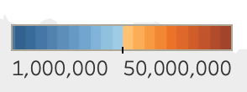
Population

Slide 4
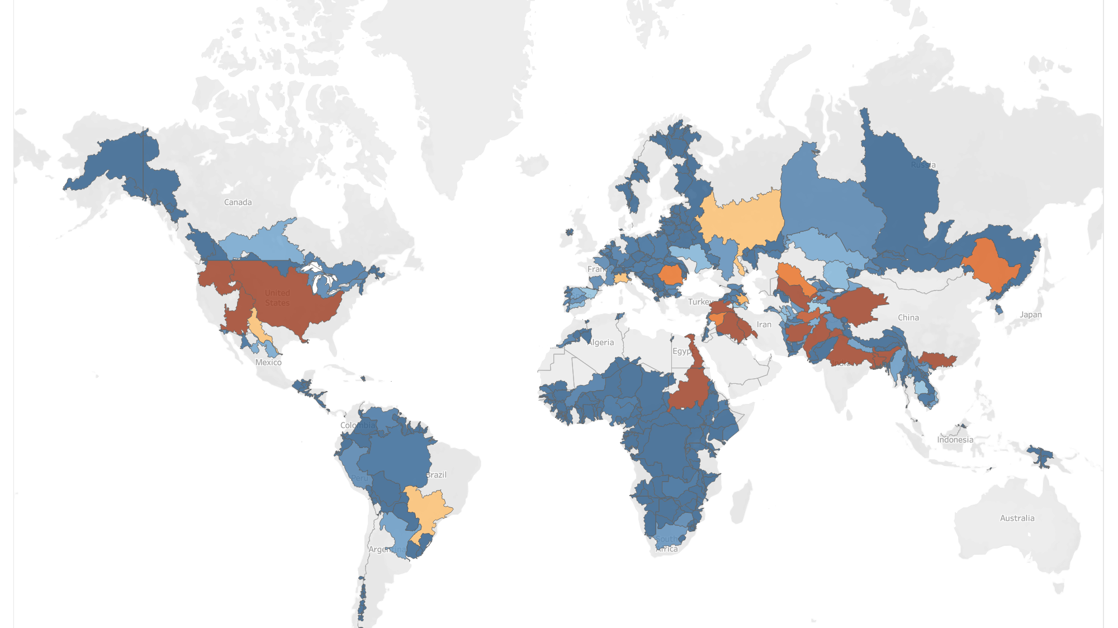
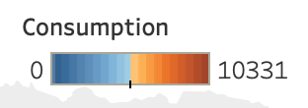
Consumption

Slide 5
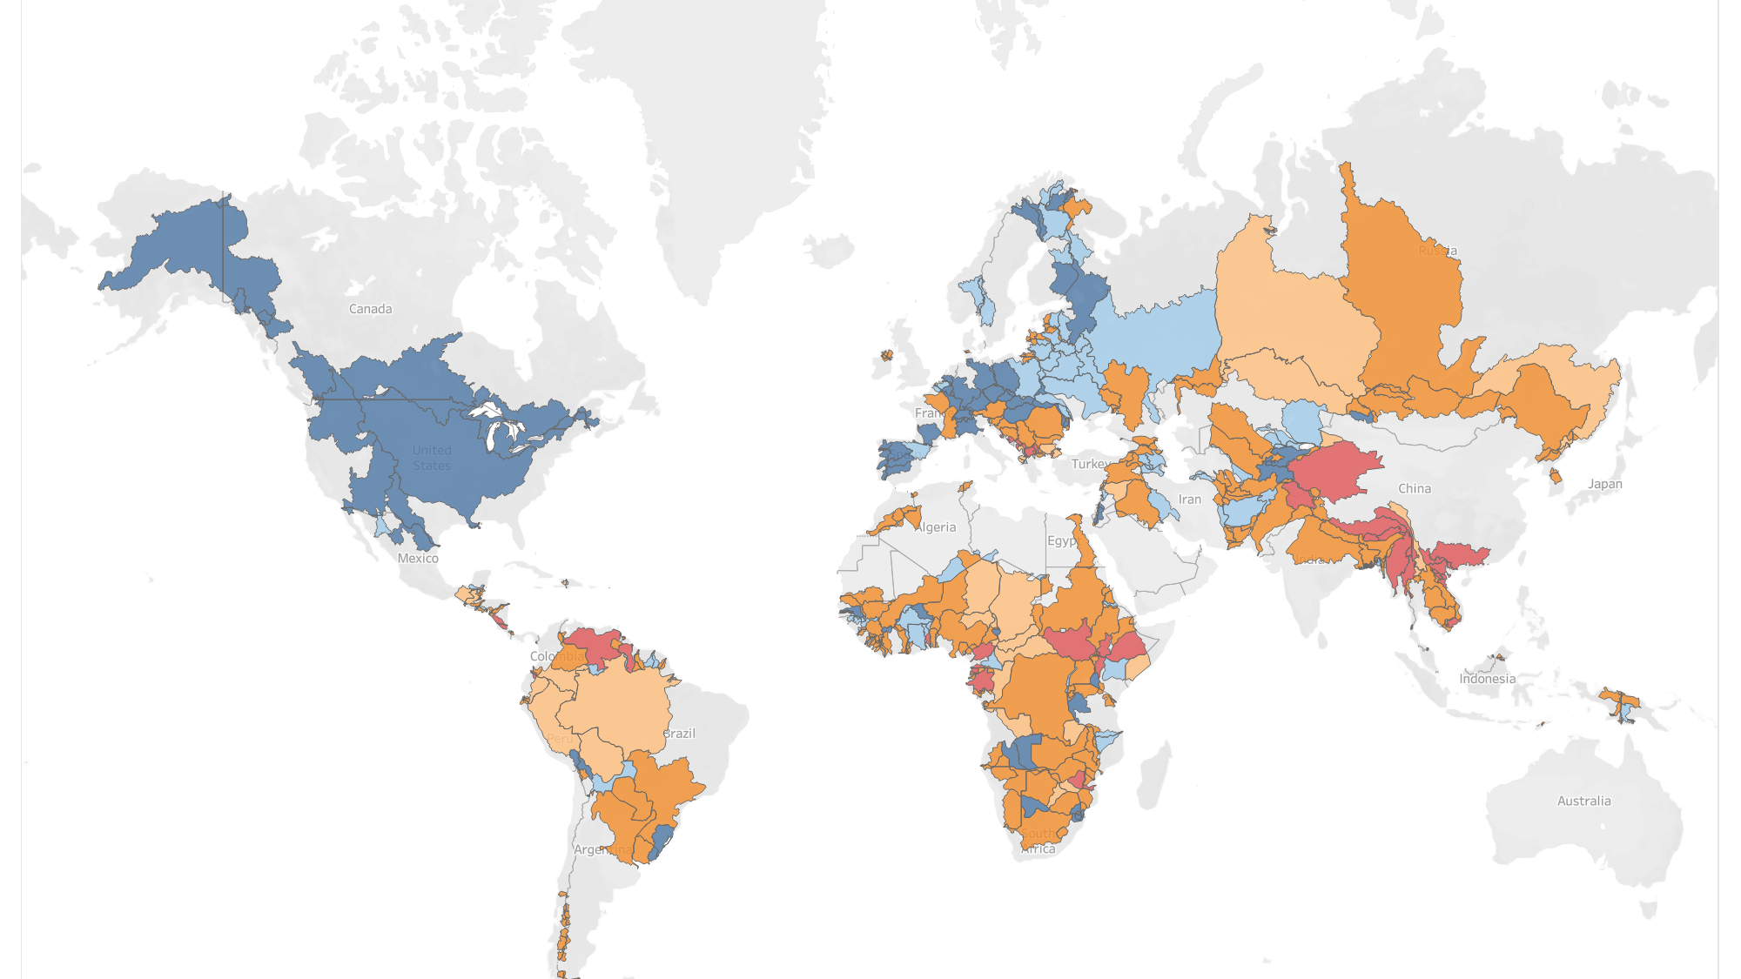
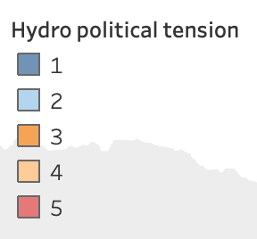
Hydropolitical tension

Slide 6
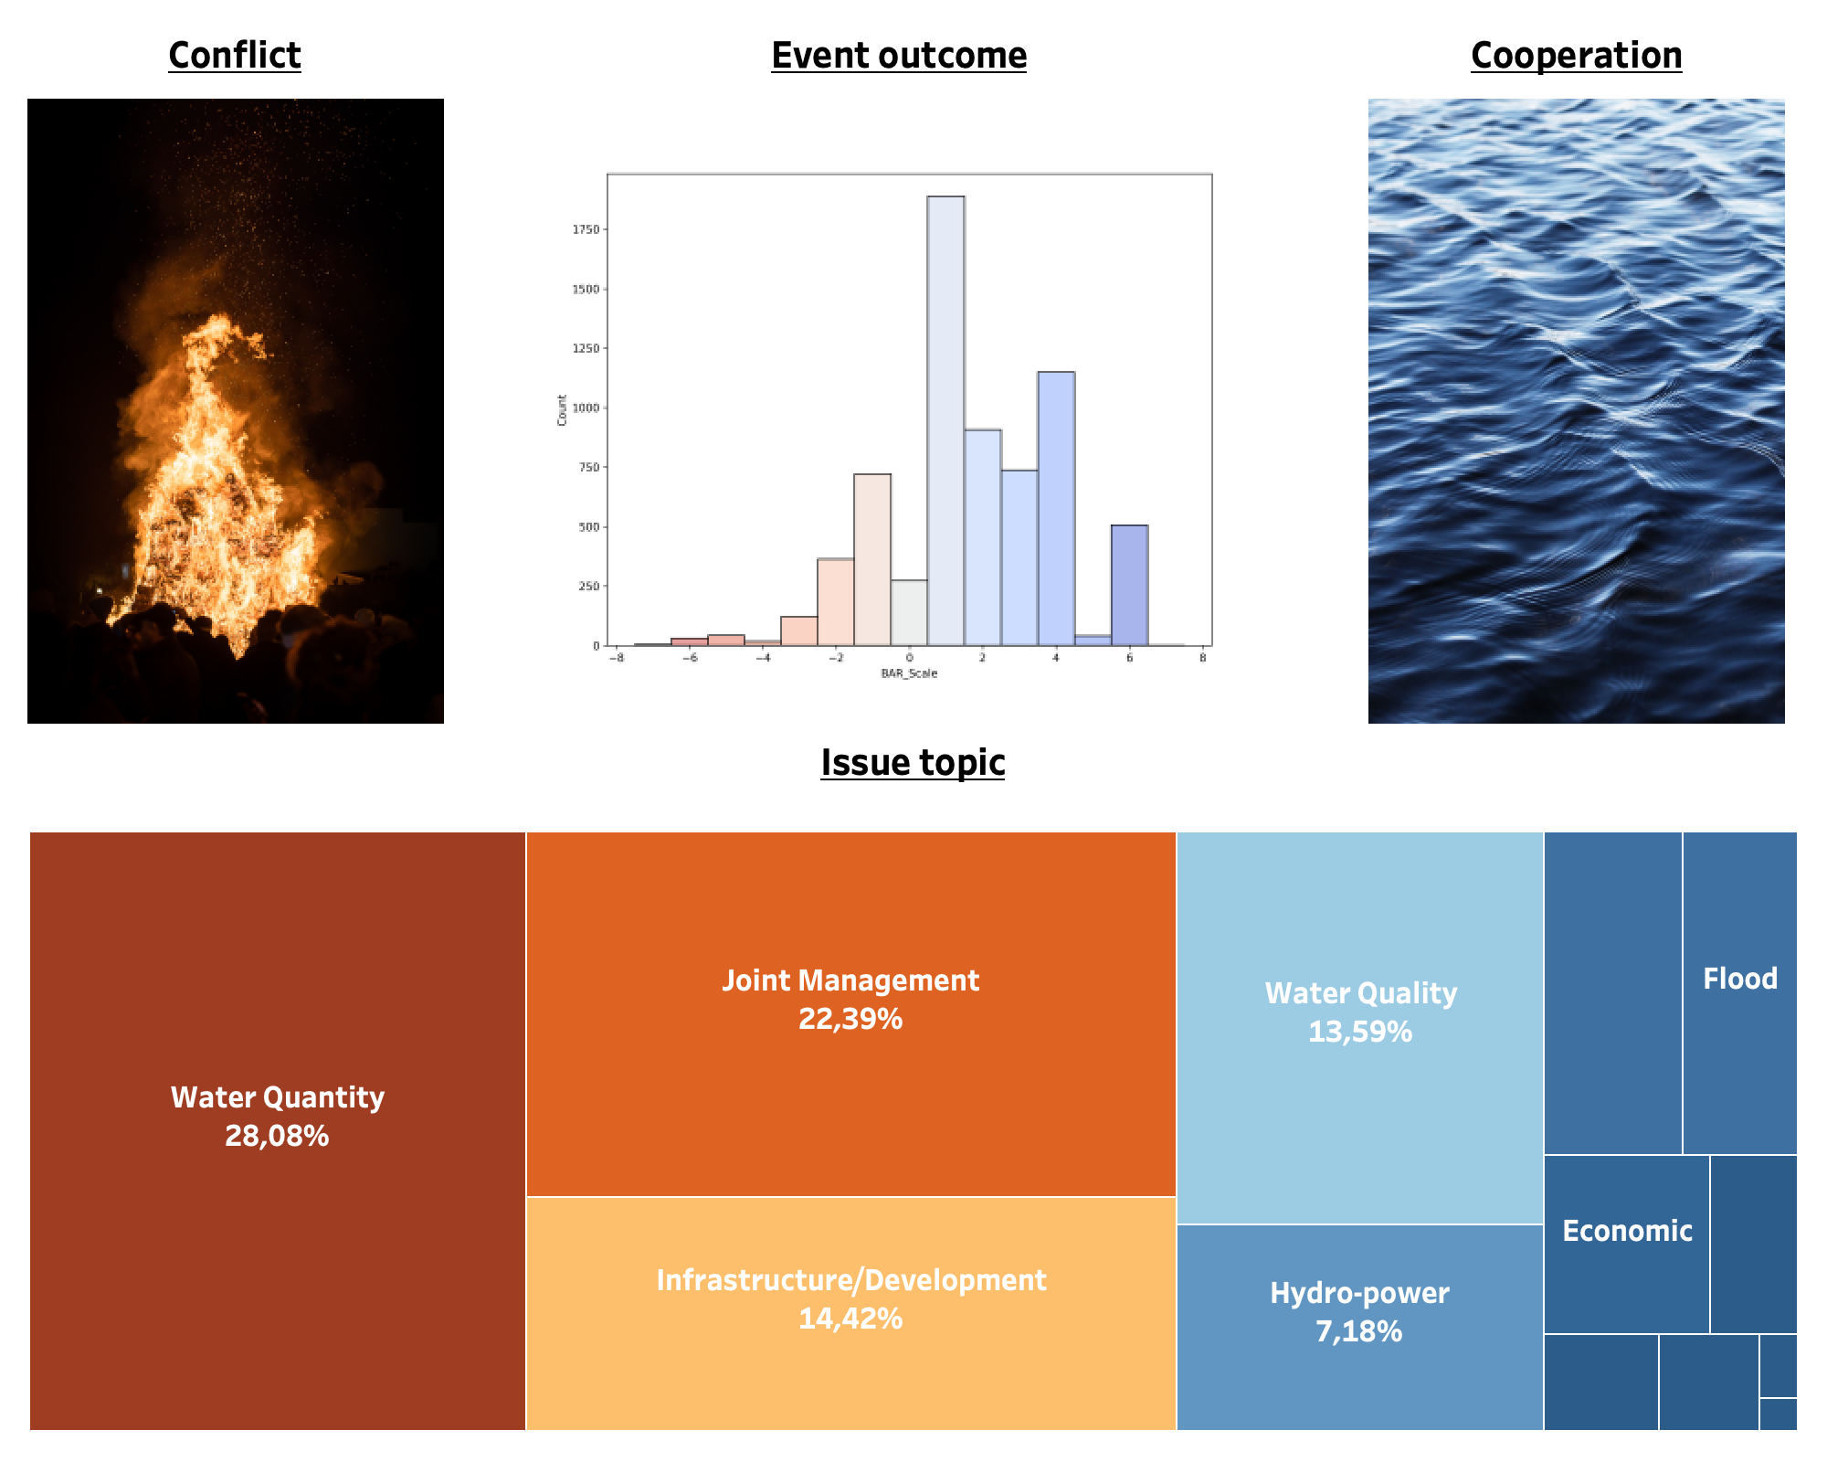

Slide 8
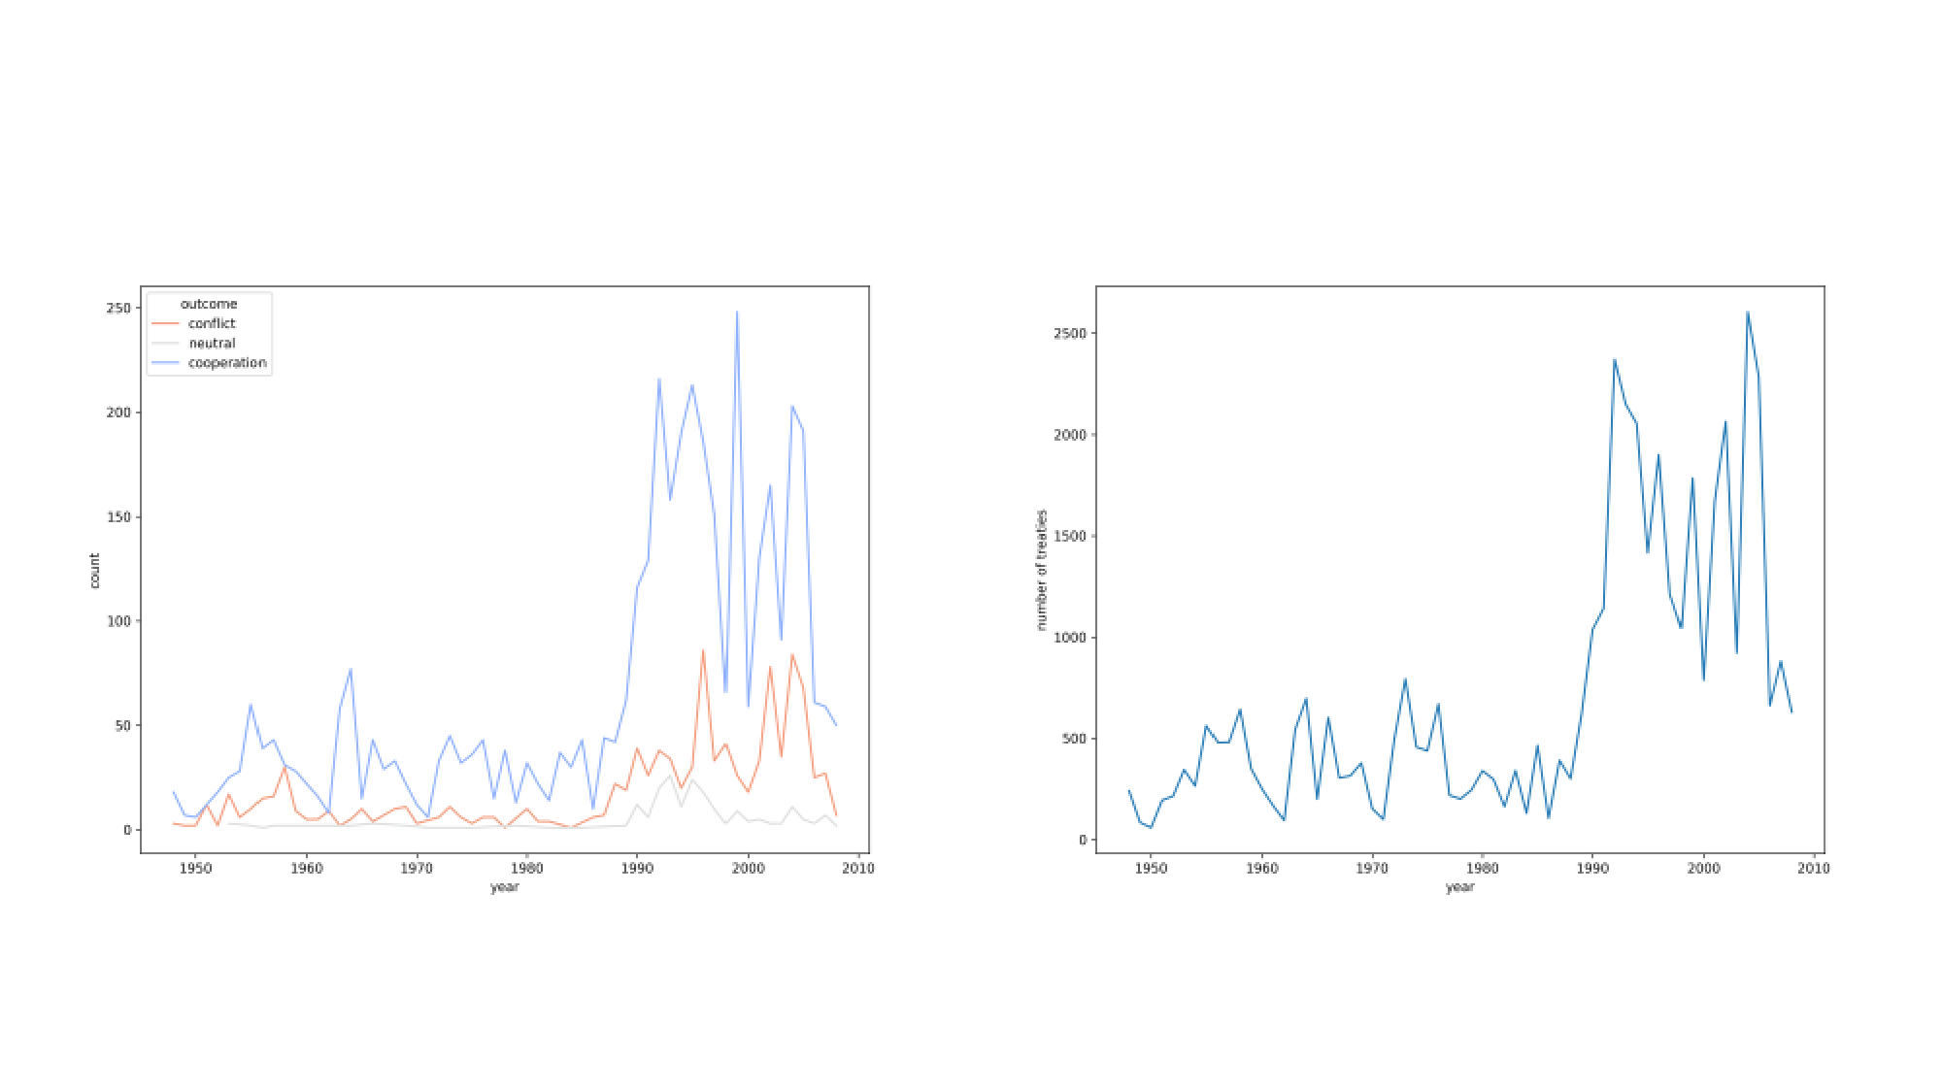
Outcome Treaties

Slide 9
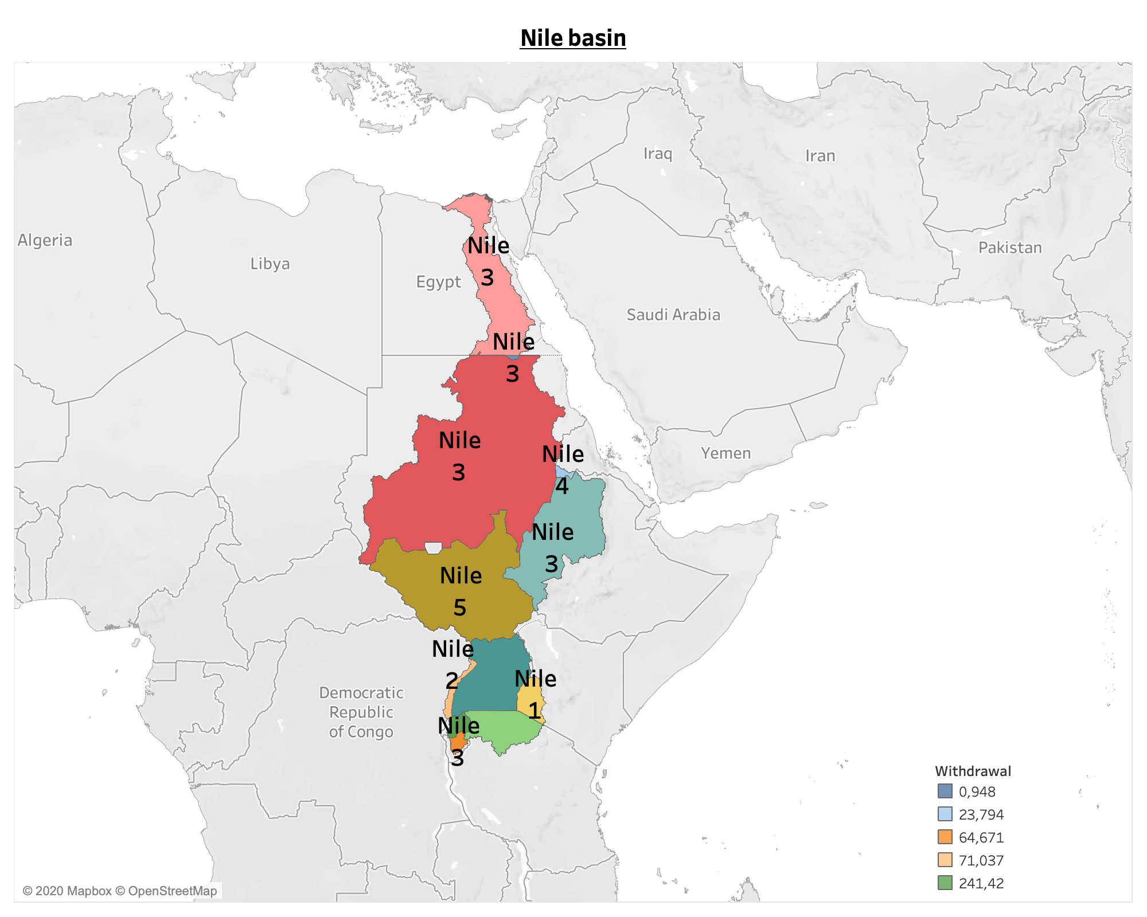
Zoom in: Nile basin

Slide 10
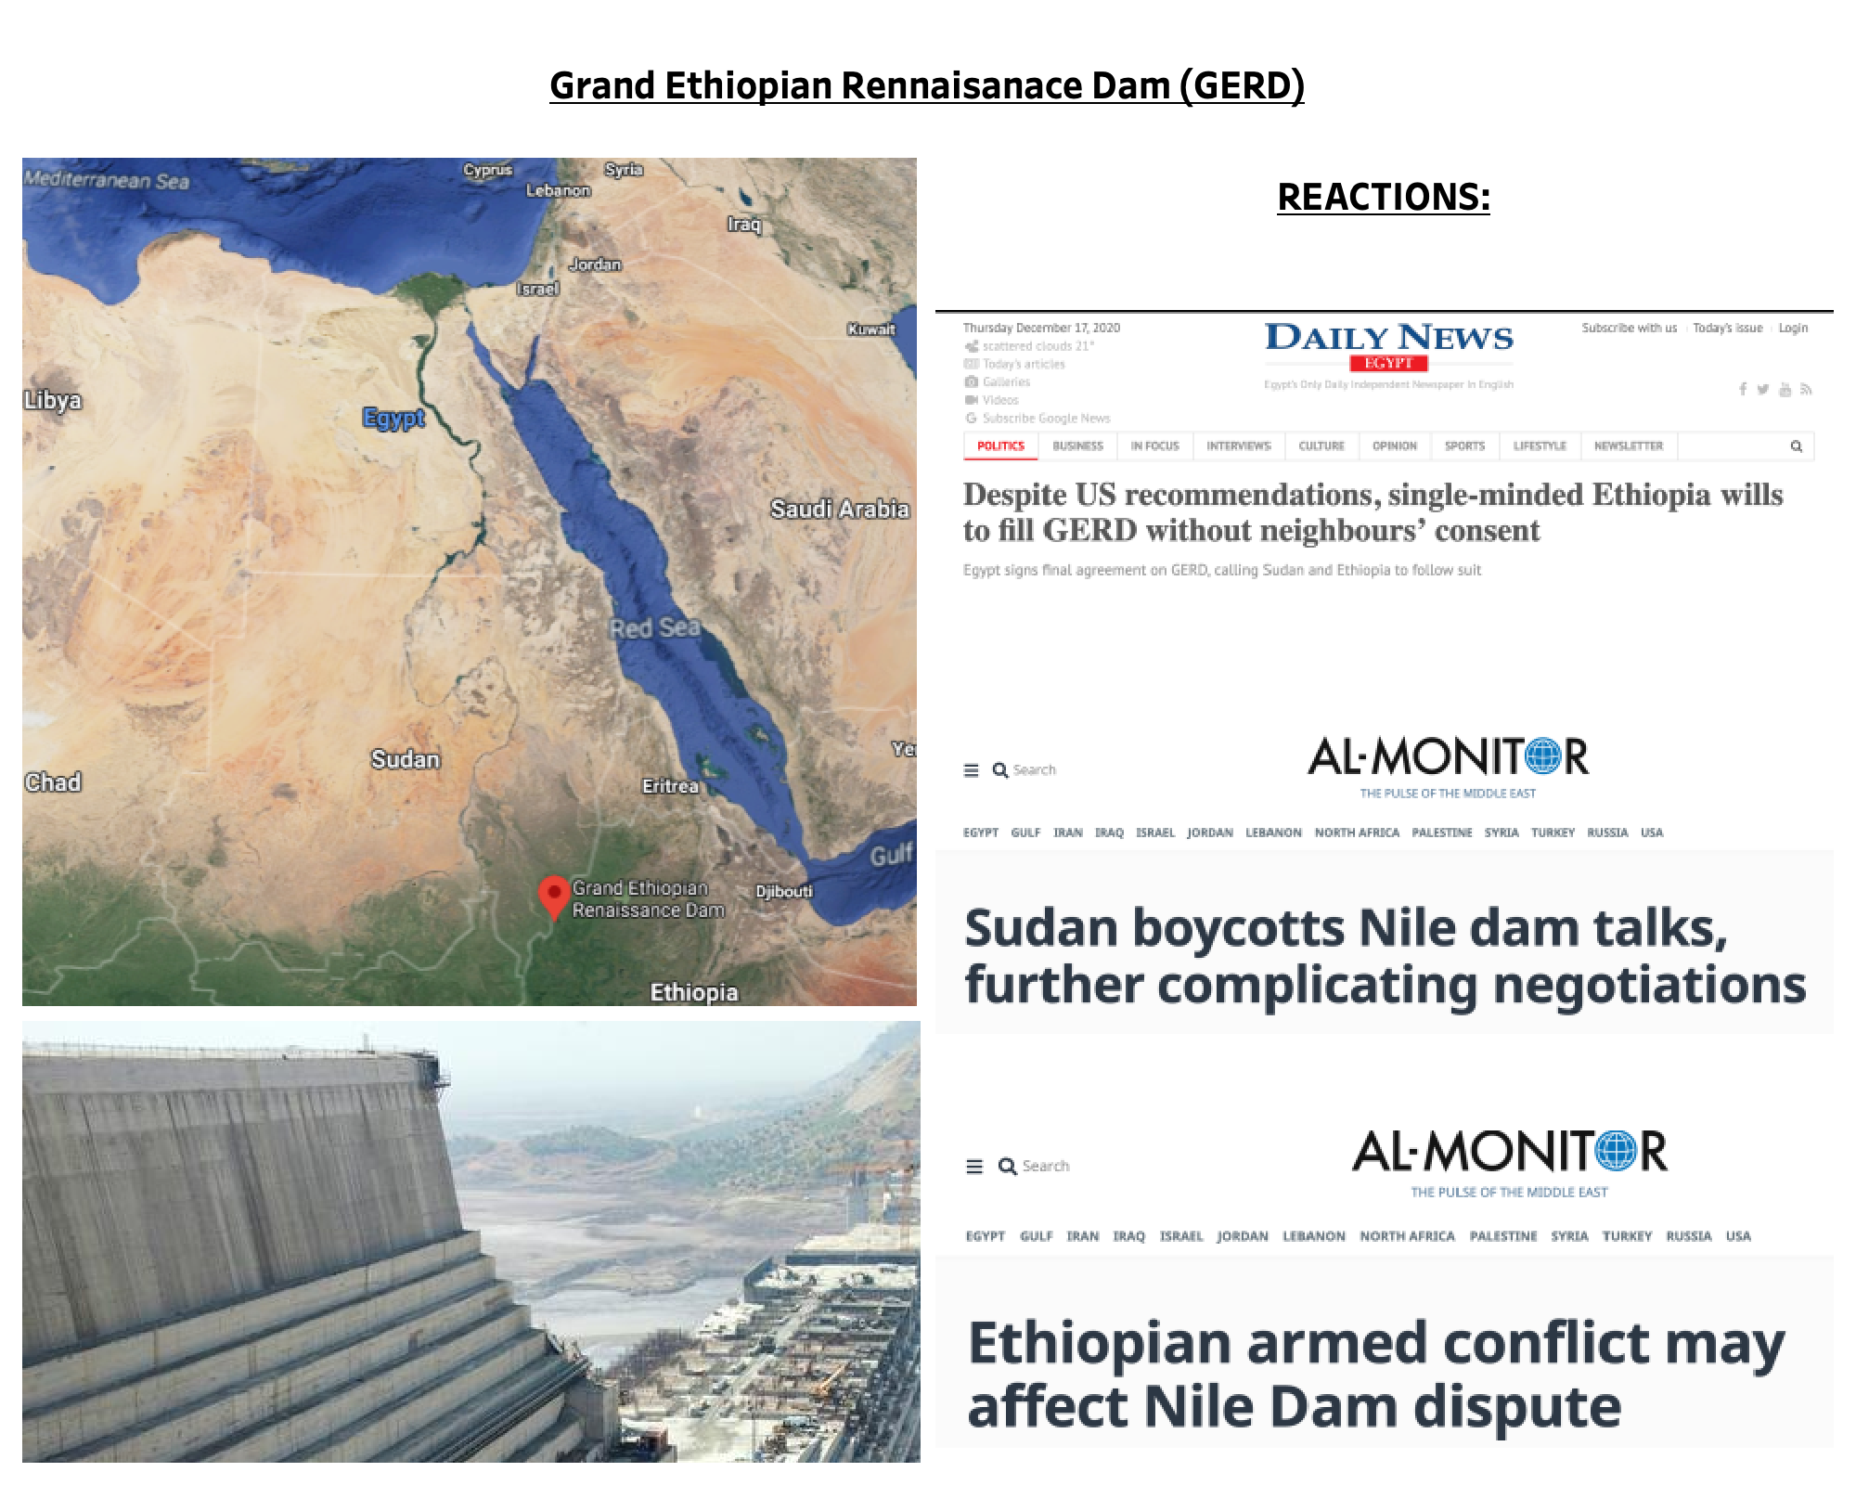
Grand Ethiopian Renaissance Dam (GERD)
Notes:
Largest dam
4.8 billion usd 5% of GDP
No aggreement in place
Pssibly 25% reduction in flow

